Slide 1
Laser Tag: Flipping Bits in DRAM using Laser Induced Localized Heating
Saurav Mathur, Nirmit Jallawar, Swamit Tannu

Slide 2
DRAM is everywhere and it’s vulnerable

Slide 3
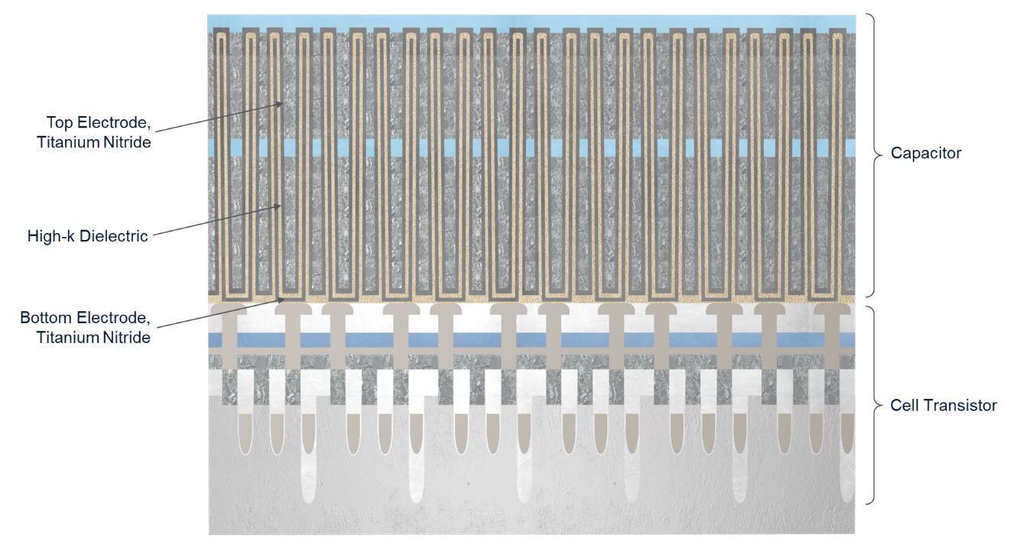
Source of Vulnerability: DRAM Scaling
Scaling continues to improve density with sub 20nm technology
Small feature size increasing vulnerability
Source: Applied Materials

Slide 4
Challenges in characterizing Row Hammer
Hidden mappings – unknown internal row-level arrangement
Uncertainty introduced by Out of Order Cores, ISA, OS, ..
RH defenses such as TRR makes characterization challenging
Future designs can make RH characterization even harder
Source: Are We Susceptible to Rowhammer? by Cojocar et al.

Slide 5
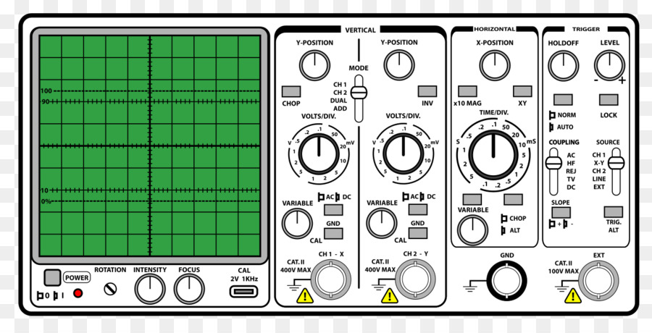
Characterization Strategies for Row Hammer
Probing + Refresh Blocking
Custom Memory Controllers
Timing Side
Channels
CPU
CPU
FPGA
Characterization Method | Reverse Engineering
Software only | Timing Side Channels, Perf Counts
FPGA + Custom MC | Row Hammer
Probe + Refresh Block | Row Hammer
MC
MC
Cust. MC
Source: Cojocar et al.

Slide 6
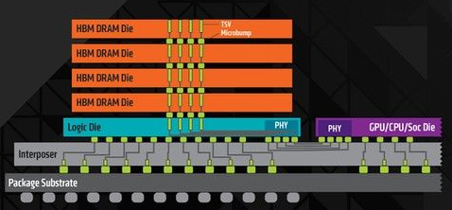
Challenge: Growing Complexity of DRAM
Package on package
DIMM

Slide 7
Goal
Develop precise “pin-less” fault injection for DRAM that can –
(1) Uncover DRAM + MC vulnerabilities: work with any MC
(2) Enable Fine-grained reverse engineering
(3) Enable reverse engineering immune to layers of in-directions

Slide 8
DRAM is vulnerable to increased temperature Insight: Lasers can induce local and precise hot spots to flip bits in a tiny physical region

Slide 9
Outline
Motivation and Goal
Laser Tag Setup
Evaluations
Experimental Challenges
Conclusion

Slide 10
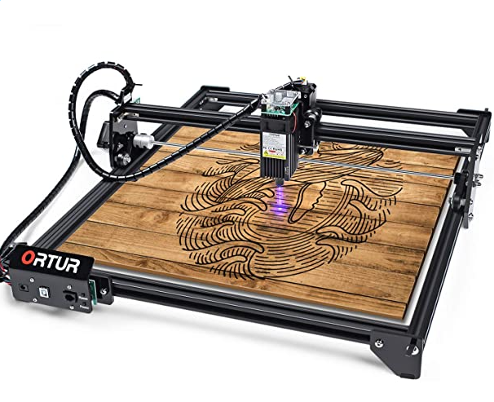
Engravers to get local hotspot on DRAMs
We use off-the shelf wood engraver with diode-laser for fault injection
Laser mounted on CNC enables precise movement in the XY plane
Key insight: 2W optical power enough to cause bitflips in DRAM

Slide 11
Laser Tag Workflow
Write 0s to all memory cells
Laser part of the chip
Read and check the data
Store errors and addresses
CPU
Laser

Slide 12
Experimental Setup
Laser with 5W optical power and 450 nm wavelength
Control duty cycle, engraving speed, and geometry of incidence
Test DRAM Specification
Protocol | #Chips | Vendors | Chip Capacity
DDR3 | 16 | A, B, C | 512MB, 1 GB, 2GB
DDR4 | 12 | A, B,C, D | 512 MB, 1 GB
LPDDR4 | 2 | A | 4 GB

Slide 13
Outline
Motivation and Goal
Laser Tag Setup
Evaluations
Experimental Challenges
Conclusion

Slide 14
Evaluations: Repeatability in Faults
Laser
Unique Erroneous
Addresses
Experimental Run
Laser induced bit-flips are repeatable across multiple runs

Slide 15
Evaluations: Specificity of Induced Faults
1. Solid Line (S)
S
D
Number of Errors
2. Dashed Line (D)
S and D have identical location
and length
Hotspots are local and heat does not spread too quickly

Slide 16
Data-dependence of Fault-Injection
Fraction of Errors
Hotspots can cause both 1 → 0 and 0 → 1 flip

Slide 17
Outline
Motivation and Goal
Laser Tag Setup
Evaluations
Experimental Challenges
Conclusion

Slide 18
Experimental Challenges
#faults and power relationship is non-linear
#faults are location dependent
Test Chip | Location-1 | Location-2
DDR3-1A1 | 126 | 10125
DDR4-2B3 | 1751 | 10540
LPDDR4-2 | 174 | 10219
Chip-1
Number of Errors
Chip-2
Laser Power (%)

Slide 19
Laser Induced Package Wearout
Visible wear out at high laser power
All chips were functional no permeant faults even after large wear-out signs and prolong tests
Package epoxy burning can be fixed by using standard laser-engraver/cutter tricks

Slide 20
Outline
Motivation and Goal
Laser Tag Setup
Evaluations
Experimental Challenges
Conclusion

Slide 21
Conclusion
Need tools to understand memory vulnerabilities better
Current strategies may not work in future
We present Laser Tag, a repeatable and precise fault-injection methodology for DRAM that can be used to reverse engineer internals and uncover new vulnerabilities

Slide 22
Secure and Sustainable Computing
Quantum Computer Architecture
Swamit Tannu
stannu@wisc.edu

Slide 23
Laser Tag: Flipping Bits in DRAM using Laser Induced Localized Heating
Saurav Mathur, Nirmit Jallawar, Swamit Tannu

