Slide 1
Panopticon: A Complete In-DRAM Rowhammer (RH) Mitigation https://github.com/microsoft/Panopticon
Tanj Bennett*, Stefan Saroiu, Alec Wolman, and Lucian Cojocar
Microsoft, *Avant-Gray LLC
DRAMSec 2021
June 17th, 2021
For in-depth background on DRAM and RowHammer
see https://youtu.be/duNJzNkVKbQ
Notes:
Hello everyone. My name is Stefan Saroiu and I am a researcher at Microsoft. Today, I will be presenting Panopticon which is our proposal for fixing RowHammer once and for all. Panopticon requires no changes to any hardware components other than DRAM. While some DRAM today offers forms of RowHammer mitigations, these mitigations are incomplete because they can only stop certain limited forms of RowHammer attacks. In contrast, Panopticon is a complete RowHammer mitigation – if properly implemented and configured, no RowHammer attack can bypass Panopticon. We open-sourced a simple simulator of Panopticon.
Before I begin, I would like to make two quick points. First, throughout my presentation, I will sometimes use RH to abbreviate the word Rowhammer. And second, I will assume you are familiar with DRAM and Rowhammer. Unfortunately, I will not present these in my talk due to time reasons. If you are unfamiliar with DRAM or with Rowhammer, you can find many presentations online on these topics. We have our own presentation that goes in much more depth.
<click>
Here’s the URL for your notes. But there are many other good introductions to these topics you can find online.
This is joint work with Tanj Bennett, Alec Wolman and Lucian Cojocar. All this work was done at Microsoft.

Slide 2
Why is Rowhammer Still with Us?
Nearly a decade after Rowhammer first emerged, DRAM remains as vulnerable as ever
It affects all types of DRAM: DDR/LPDDR/GDDR
Newer DRAM is more vulnerable to RowHammer than older DRAM
Despite much research, complete mitigations are not yet deployed
State-of-the-art schemes still too expensive in practice (require too much CAM/SRAM)
Most mitigations require costly changes at multiple hardware/software layers
Notes:
<click>
Nearly a decade after the first Rowhammer publication, DRAM remains as vulnerable as ever.
<click>
Rowhammer is not limited to a particular type of DRAM. It affects all forms of DRAM.
<click>
Recent work has shown that DDR4 DRAM is in fact more vulnerable than DDR3, and that newer DDR4 is more vulnerable than older DDR4. In general, newer DRAM is more vulnerable to RowHammer than older DRAM. Rowhammer remains a significant threat to DRAM’s security and reliability.
<click>
The research community has proposed many mitigation schemes, but unfortunately complete mitigation schemes that fix all forms of RowHammer are not yet deployed in practice. We believe there are two reasons for the lack of adoption of complete RowHammer mitigation schemes.
<click>
First, these schemes still come with cost and performance downsides requiring a significant amount of additional memory like CAM and SRAM. This is considered quite expensive by hardware vendors.
<click>
A second practical barrier is that most require changes at multiple hardware or software layers such as changes to both the DRAM devices and the memory controller, or to the memory controller and the RCD chip.
Costly changes across multiple layers are difficult to implement in practice because they require the cooperation and agreement of multiple hardware and software vendors.

Slide 3
Panopticon: Complete, In-DRAM Mitigation
Main idea: implement simple counter mats inside DRAM device
Each row in a DRAM device has a corresponding counter
When counter reaches Rowhammer threshold, perform mitigation
Mechanism: open-space, staggered counter mat designs
Benefits:
Unlike most previous schemes, no need for large fast memories, such as CAM/SRAM
Counter lookup is essentially free; use DRAM’s existing row decode logic
Other than to DRAM, no other changes needed for DDR4
Should work with commodity DDR4 memory controllers
Notes:
This paper presents Panopticon, a complete Rowhammer mitigation that is both inexpensive and, in the case of DDR4, requires no changes to any hardware components other than DRAM. Panopticon monitors all row activations inside the DRAM itself.
<click>
The main idea of Panopticon is to implement simple counter mats inside DRAM devices in a way that each row in DRAM has a corresponding counter. When the counter reaches the Rowhammer threshold, Panopticon performs a mitigation.
<click>
The main mechanism in Panopticon is the use of an open-space, staggered counter mat design that leaves ample space for the counter increment and logic. All of this is done in DRAM.
<click>
Panopticon has several benefits over previous schemes.
<click>
It does not need large amounts of fast memories.
<click>
Unlike prior work, it does not need to implement a separate counter lookup circuit; instead, it re-uses DRAM’s row decoding logic to access the counter for the activated row.
<click>
And finally, in the case of DDR4, it requires no changes to any components other than DRAM. It should work with commodity DDR4 memory controllers.

Slide 4
Outline
Introduction and motivation
Prior work and its shortcomings
Panopticon: high-level overview
Panopticon: DRAM architecture
Security analysis
Conclusions
Notes:
This is an outline for the rest of my talk. I just finished presenting an introduction and the motivation of Panopticon. Next, I’ll present in a little more depth the prior work and describe its shortcomings.

Slide 5
4 Prior RH Mitigation Approaches
Tracking Rowhammer events, such as DRAM row activate or cache miss (BlockHammer [HPCA ‘21], Graphene [MICRO ‘20], TWiCe [ISCA ‘19], any many others…)
Mitigation is performed whenever tracking detects an ongoing attack
Sampling Rowhammer events at a fixed rate (PARA [ISCA ‘14], PRA [CAL ‘14])
Mitigation is performed proactively on each sample
Partitioning memory into isolation perimeters to confine attacks (ZebRAM [OSDI ‘18], GuardION [DIMVA ’18], Hammer Time [HotOS ‘21])
Clean-slate approaches: inter-cell energy barriers, deep trench isolation (Doping Profile [IEEE T-DMR ’16], Physics of Insecurity [IEEE T-ED ’21])
Notes:
Most previous approaches can be classified in four categories:
<click>
First, is tracking approaches. These approaches track microarchitectural events associated with Rowhammer to detect an ongoing attack before it has a chance to succeed.
<click>
Next is sampling approaches. These approaches randomly sample microarchitectural events associated with Rowhammer. They proactively perform a Rowhammer mitigation on each sample.
<click>
Third is partitioning approaches that compartmentalize memory and isolate an adversary from other co-located potential victims. When memory is properly compartmentalized, a Rowhammer attack in one memory perimeter cannot affect co-located potential victims.
<click>
Finally, clean slate approaches. These approaches require significant changes to the memory hardware including DRAM fabrication technology, DRAM devices, or DIMMs. The fundamental nature of these changes eliminate the threat of Rowhammer by design.
<click> In this talk, I’ll describe tracking approaches only. For a description of the remaining three categories, please see our paper.

Slide 6
1. Tracking has Significant Cost Overhead
State-of-the-art tracking aims to use fewest counters to track all rows
All require costly CAM/SRAM to implement counter lookup or hashing tables
For example, Graphene requires an astonishingly small state
Only 2,511 bits can track entire DDR4 bank -- O(100K rows)!
But this quickly adds up
1 DDR4 channel has up to 128 banks, 1 CPU up to 4 channels
 | Per-Bank (bits) | Per-Channel (KB) | Per-CPU (KB)
Graphene | 2,511 | 39.23 | 156.9
BlockHammer | 13,312 | 208 | 832
TWiCe | 22,200 | 346.88 | 1,387.5
Notes:
Let me explain why current tracking approaches still have significant cost overheads. Most proposals aim to figure out how to use fewest possible counters to track all rows in a DRAM device. To accommodate this sophisticated logic, these schemes require CAM or SRAM to implement for example a counter lookup table or, say, a hash table.
<click>
For example, Graphene is one such state-of-the-art tracking scheme. Graphene is quite impressive. It requires only about 25 hundred bits to track an entire DRAM bank. This is hundreds of thousands of rows. That’s impressive!
<click>
Unfortunately, this modest overhead quickly adds up due to the large degree of parallelism found in DRAM. This table shows the state overhead for DDR4 of three modern tracking approaches, Graphene, Blockhammer, and TWiCe. Like I said before, Graphene, require about 25 hundreds bits per bank. But a channel can access up to 128 banks, and 1 cpu can have up to 4 channels. So, the per-CPU state is now more than 150 kilobytes of CAM. While not unsurmountable, this overhead is still significant.

Slide 7
2. Tracking Require Changes at Many Layers
Most prior works’ implementations are outside the DRAM device
Either in memory controller or in RCD
Performing mitigation requires DRAM device’s cooperation
Counters track aggressor rows, but mitigations must be done to victim rows
Only DRAM device knows victim rows’ identity
Prior works propose new DDR command: Nearby Row Refresh
Memory controller reports aggressor rows to DRAM
DRAM’s responsibility to identify and refresh all victims
Notes:
The second problem with tracking approaches is that they require changes at many layers.
<click>
Most of these schemes implement their logic outside the DRAM devices – either in the memory controller or in the RCD chip.
<click>
Unfortunately, such approaches preclude the ability to refresh victim rows without the cooperation of the DRAM device.
<click>
By tracking aggressor rows, these schemes cannot identify the affected victim rows unless they have visibility into the DRAM’s internal physical row mappings.
<click>
DRAM vendors regard internal row layout (and the mappings of logical to physical DRAM rows) as proprietary and confidential and are unwilling to share them even when they could help with mitigating Rowhammer. <click> Instead, prior works propose a new DRAM command, called Nearby Row Refresh by which the memory controller reports an aggressor row’s address and instructs the DRAM to refresh all potential victims.

Slide 8
Outline
Introduction and motivation
Prior work and its shortcomings
Panopticon: high-level overview
Panopticon: DRAM architecture
Security analysis
Conclusions
Notes:
I am now going to give a high-level overview of our approach: Panopticon.

Slide 9
Tracking
threshold bit b₁₀
b₁₀ toggles from 0 to 1
b₁₀ toggles from 1 to 0
Row # | 16-bit CNT
0x0 | 0x87FF
0x1 | 0xE806
0x2 | 0x13FF
0x3 | 0x82EE
Row # | 16-bit CNT
0x0 | 0x87FF
0x1 | 0xE806
0x2 | 0x1400
0x3 | 0x82EE
Row # | 16-bit CNT
0x0 | 0x8800
0x1 | 0xE806
0x2 | 0x1400
0x3 | 0x82EE
0x2
0x0
0x2
ACT 0x2
ACT 0x0
Counter Table
Service Q.
Counter Table
Service Q.
Counter Table
Service Q.
Performing Mitigation
Row # | 16-bit CNT
0x0 | 0x8800
0x1 | 0xE806
0x2 | 0x1400
0x3 | 0x82EE
Row # | 16-bit CNT
0x0 | 0x8800
0x1 | 0xE806
0x2 | 0x1400
0x3 | 0x82EE
Service row 0x2
0x0
0x2
0x0
Refresh row 0x0
Refresh row 0x1
Refresh row 0x3
Refresh row 0x4
Counter Table
Service Q.
Counter Table
Service Q.
Notes:
<click>
Let me start with how tracking works.
<click>
Each row has an associated 16-bit counter. Here I’m showing four rows, rows numbered zero through three. Each row has a counter tracking the number of row activates this row has received. The counter values are shown in hex.
There is also a threshold bit, bit 10. Whenever a counter value increments, if the increment toggles bit 10, then the row address is added to
<click>
a service queue.
<click>
Say that the DRAM receives a row activate of row address 2.
<click>
This increment toggled bit 10 from 0 to 1 because the value changed from 13ff to 1400.
We add row address 0x2 to the service queue.
<click>
Say that next we receive a row activate of row address 0.
<click>
This increment toggled bit 10 from 1 to 0 because the value changed from 84FF to 8500.
We add row address 0x0 to the service queue.
<click>
Next, I will show how Panopticon performs the mitigation.
<click>
To service row 0x2, the DRAM device must refresh all potential victim rows. In this example, we assume that an aggressor row can affect up to 4 victims. So, in this case, we refresh victim rows 0, 1, 3, and 4, and we dequeue the aggressor row, row 0x2 from the service queue.

Slide 10
Challenge 1: When to Service Queue?
Two possibilities:
Upon receiving REF, DRAM re-purposes some of its time for servicing queue
DRAM asks memory controller for additional time (pause)
Unfortunately, no DRAM protocol lets DRAM ask for time (hint to JEDEC!)
But, DDR4 has ALERT_{n} signal for DRAM to signal errors
Upon receiving ALERT_{n}, memory controller must re-issue failed command
Idea: To ask for time, DRAM asserts ALERT_{n} and ignores dup. commands
Notes:
Panopticon needs to address two challenges. On this slide, we describe challenge #1 – When two service the queue?
<click>
First, we envision two possibilities.
<click>
One option is that upon receiving a refresh command, the DRAM re-purposes some of its time o service the queue.
<click>A second option is that the DRAM asks the memory controller for additional time, like a put the controller on pause.
<click>
Unfortunately, no protocol lets DRAM ask for time although we think that this is a must-have feature in all DRAM protocols.
However, in DDR4, DRAM uses ALERTn to signal errors to the memory controller. Upon receiving this signal, the memory controller stops issuing new DRAM commands and instead re-issues the old memory access.
<click>
Panopticon retrofits ALERTn to effectively “trick” the memory controller to pause issuing new DDR commands. By making use of ALERTn, Panopticon requires no modifications to any hardware other than DRAM itself.

Slide 11
Challenge #2: Where to Implement Queue?
Queue’s implementation must use SRAM
DRAM vendors can size their queues as small as needed, even 1 entry
When queue is full, DRAM asks for time!
Provides way for DRAM vendors to differentiate themselves
Larger the queue, less need to ask for time (aka better perf.)
But small queue is still safe
Notes:
Now we come to challenge #2. While the counters are all stored in DRAM, where are we going to store the queue?
<click>
For the service queue, Panopticon uses SRAM.
However, this queue is small; in our performance evaluation of Panopticon, we used a queue of 8 entries per bank.
But, the DRAM vendors can size their queues as small as needed, even to a single entry for the entire DRAM device.
<click>
When the queue is full, the DRAM must ask for time.
<click>
We think this provides a way for DRAM vendors to differentiate themselves. For example, a large queue size makes DRAM have better performance because the larger the queue is, the less need to ask for time. However, and this is very important, even with a small queue Panopticon is still safe.

Slide 12
Outline
Introduction and motivation
Prior work and its shortcomings
Panopticon: high-level overview
Panopticon: DRAM architecture
Security analysis
Conclusions
Notes:
I am now going to describe the DRAM architecture of Panopticon.

Slide 13
Cell Mats Storing Data
Notes:
Sense amplifiers bridge cell-mats and connect to either the upper or the lower data arrays depending on how the DRAM circuit is activated. Mat selection is done using the equalizer (EQ\_a and EQ\_b) and isolation (ISO\_a and ISO\_b) signals.
Panopticon must keep the same spacing for the sensing and routing of the counter bits that run beside these full-length mats and use the same row lines.

Slide 14
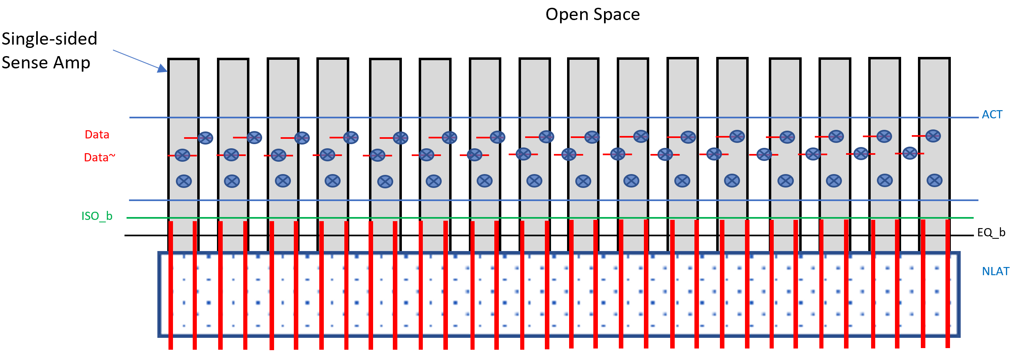
Cell Mats Storing Counters
Notes:
So first, to build a counter mat in Panopticon we will remove one of the mats – here we are removing the upper one. The cell mats have one-sided sense amps.

Slide 15
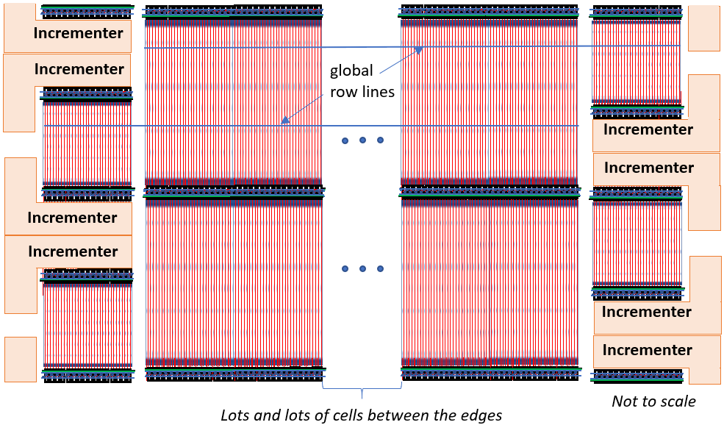
DRAM View of Panopticon
Notes:
This picture puts everything together. In the middle, we’re showing the tall data mats with the dual-sided sense amplifiers that select the top or the bottom mat. There’s lots and lots of cells between the edges.
The counter mat run beside these full-length mats and use the same row lines. They are half-length and support only half the number of rows.
Halving the counter mats' size has two important benefits.
First, the half-length data lines offer lower latency for counter increments within the time needed to read the data cells. Second, it creates a large open-space adjacent to the sense amplifiers to place logic for an incrementer (and also for testing). The location is ideal because it has access to all process layers including interconnect to create the logic needed for controlling and operating the incrementer.

Slide 16
Security Analysis: Is It Difficult to Create Undesirable Scenarios?
Scenario #1: Place rows in service queue in back-to-back refresh intervals
Scenario #2: Fill up the service queue
Are these undesirable scenarios difficult?
Answer: NO!
But DRAM remains safe (when scenario occurs, Panopticon triggers ALERT_{n})
Notes:
We also performed a security analysis of Panopticon. We wanted to understand how difficult is to create undesirable scenarios for DRAM, such as
<click>
placing rows in the service queue during several consecutive, back-to-back refresh intervals (tREFI) and
<click>
filling up the service queue.
<click>
Are these undesirable scenarios difficult?
<click>
The answer to is NO. Attackers can create both of these scenarios with relative ease.
<click>
However, as long as Panopticon can put things on hold and ask the memory controller for time to perform the mitigations, the DRAM remains safe
<STOP>
First, we said that DRAM could re-purpose REF commands to perform RowHammer mitigation and service the queue. Upon receiving a REF, Panopticon would check whether an entry is present in the service queue. In that case, the REF would be “hijacked” away from background refresh to perform the Rowhammer mitigation. This model works as long as the hijacked REFs are spread evenly throughout a refresh window. An uneven spread in which rows are placed in the queue in each several consecutive refresh intervals (tREFI) could cause undesirable interference with the background refresh schedule. So the first question investigated was – is it difficult for an attacker to create this uneven spread and place rows in the queue in consecutive refresh intervals?
The second question raised is – it is realistic to make my queue large enough so that it is never full?
<click>
For both these questions the answer is no – it is easy for an attacker to add rows to the service queue consistency during each tREFI, and it is also easy to fill up the queue. To remain safe under such scenarios, the DRAM must be able to ask the memory controller for additional free time.
For more details on our analysis, please see our paper.

Slide 17
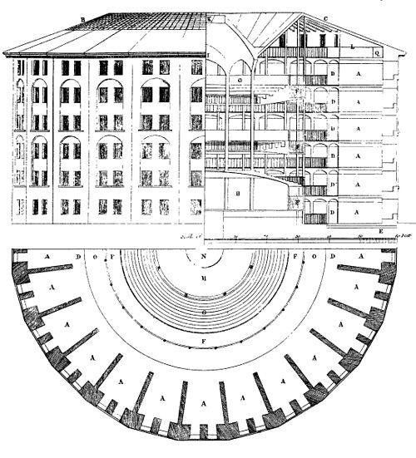
Conclusions
Complete in-DRAM RH mitigation
No changes to other hardware components
Leverage ALERT_{n} to ask for time
https://github.com/microsoft/Panopticon
Plan of Jeremy Bentham's panopticon prison, drawn by Willey Reveley in 1791
Notes:
Panopticon is a complete in-DRAM Rowhammer mitigation that is both inexpensive and, for DDR4, requires no changes to any hardware components other than DRAM. For more information, please read our paper and see our simulator code on Github.
Thank you.
<stop>
Panopticon uses a novel DRAM mat design to implement counters and the DRAM’s row decoding logic to access the row’s corresponding counter. Finally, for DDR4, Panopticon leverages ALERTn to stop a memory controller from issuing new DRAM commands whenever it needs time to refresh potential victim rows.

