Slide 1
Rethinking ECC in the Era of Row-Hammer
Moinuddin Qureshi
(Invited Paper at DRAM-Sec @ ISCA 2021)
Notes:
Hello, I am Moin Qureshi from Georgia Tech. I will be talking about rethinking ECC designs for Row Hammer. But before I do, let me discuss

Slide 2
Risk Management 101
Known
Knowns
Known
Unknowns
Unknown
Unknowns
Soft Error,
Chip failure
FIT Rates
New Failure Mode
Higher FIT Rates
New Attacks
New Vulnerability
Focus of this talk
Notes:
a bit about Risk Management. When we are trying to protect a computer system, we can classify the threats into three buckets.
Things we know – from memory point of view, these would be soft errors, single bit failures, chip failures. We know the historical rates for these, and protect against these very well.
Then there are things we know we don’t know – like new failure modes, higher FIT rate for new technology. We try to make educated guesses and build solutions.
Finally, there are things we don’t know we don’t know – like new forms of attacks that are beyond our current imagination. This is what causes the most headaches and vulnerabilities.
While designing future solutions, it is important to that we should be thinking about the second and the third bucket. And, I will be talking about such an approach.

Slide 3
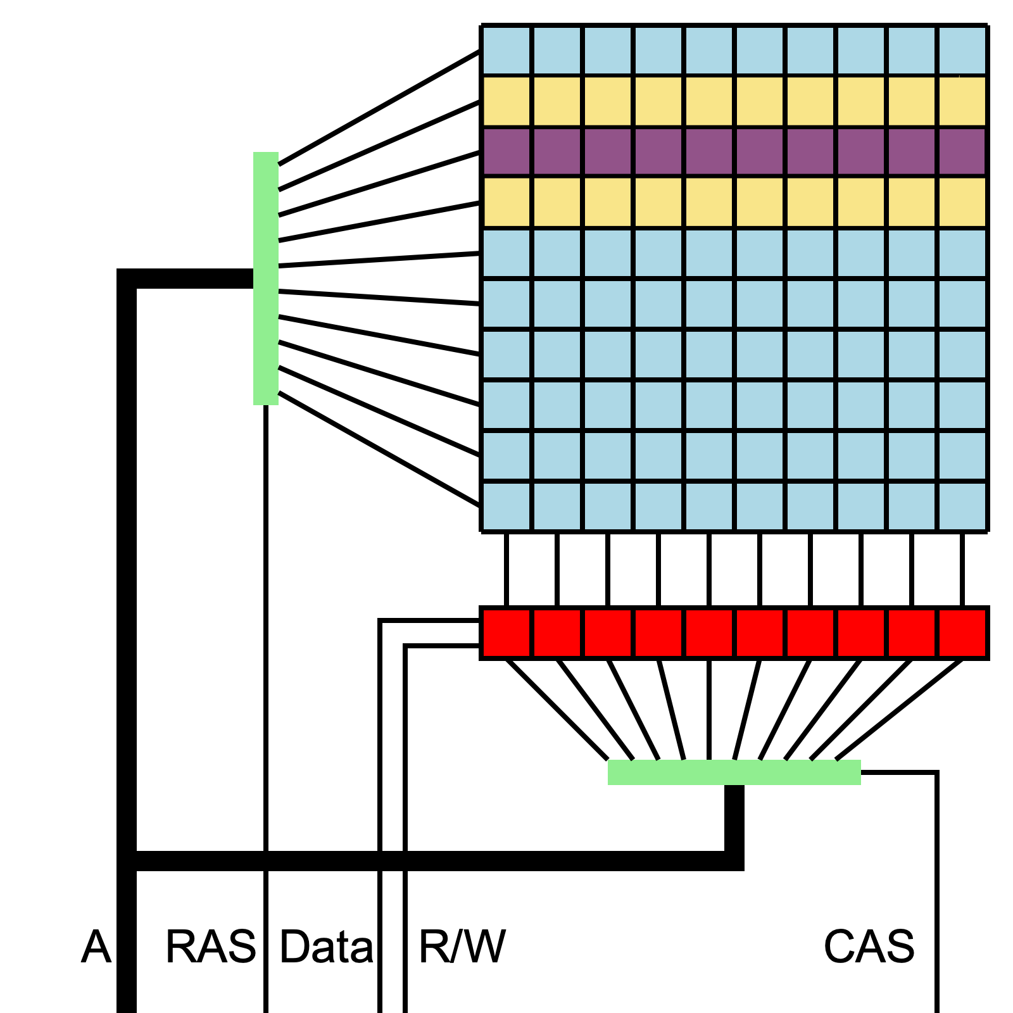
Background on Row-Hammer
Aggressor Row
Victim Row (bit flips)
Aggressor Row
Row Hammer happens due to inter-cell leakage
Activations on neighbor rows cause flips in victim
Image source: wikipedia
Row Hammer is a reliability and security threat
Notes:
Lets talk about Row Hammer. Technology scaling brings cells closer and increases leakage.
When a row is accessed, it causes a small amount of charge leakage from cells of neighboring rows. You access the rows enough, then a victim row can have bit flips. For example accessing the “yellow aggressor rows” In succession a large number of times can cause flip in the “purpose victim row”
Row-Hammer was first demonstrated in 2014 and has continued to be a reliability and security threat for the past 7 years.

Slide 4
Row-Hammer Defenses
Increases the Refresh Rate
Refresh rates of 32ms and 16ms reduces RH
Power and performance overheads
Not guaranteed to eliminate RH
Proactively Refresh Victim Rows (Probabilistic/Counter)
Based on “RH Threshold” – threshold varies across bits/time
Need location of victim rows – not provided by vendor
How many neighbors to protect? Distant neighbors get affected too
Rely on ECC to Tolerate Row-Hammer?
ECCploit demonstrated RH on SECDED memories
ECCploit discusses possible attack on Chipkill memories
No guaranteed solution for Row-Hammer
Notes:
There have been several solutions that try to mitigate Row Hammer. For example,

Slide 5
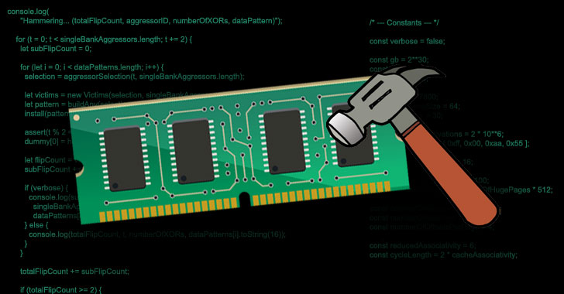
The “Unknown Unknowns”
RH ATTACK
System
Hijacking
Breaking
Confidentiality
Row Hammer
Solution
Guaranteed solution – works for all systems/attacks
(no need to worry about RH anymore)
All solutions will have some weakness (new attacks)
(focus on detecting when RH eventually occurs)
Important area
We encourage this!!
Notes:
Row Hammer is not just a realibility problem, it is a serious security threat, where it can cause takeover of the system and leakage of sensitive data.
There is a lot of ongoing work on trying to mitigate RH, and we encourage research in this important area
There are two ways to think about RH hammer solutions: The solution can provide guaranteed solution that works across different systems and attacks. If that is the case, we don’t have to worry about Row Hammer anymore.
However, if seven years have thought us anything, it is that solutions have weaknesses. And it is not a question of “if the solution can be broken” but ”when”. It would be wise to assume that even with mitigations future systems could be susceptible to RH. When that happens we want to know that RH has occurred, so that we can prevent bad things from happening, like hijacking of the system. Ideally, we want integrity protection, but without paying for it.

Slide 6
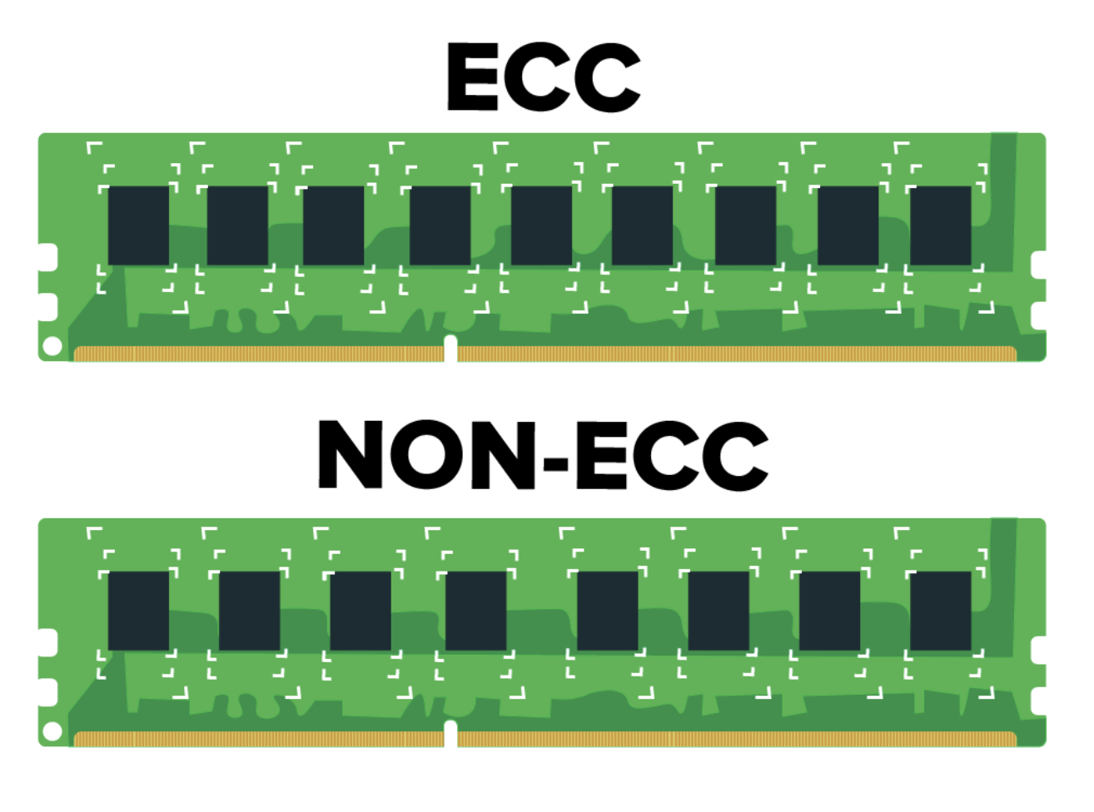
Proposal: Rethink ECC Designs
Server memory is made of ECC-DIMMs ➔ Use it for strong detection
 | Correction | Detection
SECDED | 1-bit | 2-bit
Chipkill | 1-chip | 2-chip
Detection is usually a byproduct of correction
Can we have “Integrity protection” within ECC bits?
Goal: Equip ECC with strong detection, while maintaining correction
Notes:
Server memories employ error correcting modules where they contain an extra chip to store the ECC code. ECC serves the purpose of error detection and correction.
The two commonly used error correction codes in DRAM are the SECDED code which can correct single error and detect an error of two bits. Chipkill that can correct the failure of one chip and detect failure in up-to two chips. In conventional codes, the detection capability is really a byproduct of the correction capability – we design the ECC code primarily for correction.
Can we leverage ECC bits to provide strong detection while retaining the correction capability?

Slide 7
Integrity-Protected ECC Memory
Conventional-SECDED
IPEM at 64-byte Granularity
ECC
SEC
MAC
DATA (64-bit)
8-bit
ECC
64-byte DATA (across 8 transfers)
SEC
MAC
(8 transfers of 8-byte data each)
Detection is byproduct of correction
(64-byte data + 10-bit ECC-1 + 54-bit MAC)
IPEM provides strong detection while having ECC-1 for 64-byte line
Notes:
Conventional SECDED code is designed at an 8-byte granularity. For each bus transfer we get 64-bits of data, 8-bits of ECC, where 7 bits are required for SEC, and 1 bit for the double error detection.
However, we don’t interact with memory at a 8byte granularity anymore. We interact at 64-byte granularity, so why have the ECC code at 8-byte.
Our proposed IPEM design operates the code at 64-bytes. We get 64-bits of information from the ECC chip, we need only 10-bits for single error correction of 64-byte line, and we can use 54-bits for storing the MAC for integrity check.
In practice, the chance of two single bit error striking two independent words of a 64-byte line is negligibly small, so increasing the correction granularity provides similar reliability. But more importantly, with MAC we would know when a Row Hammer occurs, all within the same space as conventional SECDED.

Slide 8
How about Chipkill?
Symbol-based Code
18 chips (4-bit wide)
Single-Symbol-Correct
Double-Symbol-Detect
S9
SA
S0
SD
SG
SB
SC
S0
SE
SF
SH
S0
S1
S2
S3
S4
S5
S6
S7
S8
72-bit per transfer = 18 symbols of 4-bit each
(8 transfers for getting 64-byte data)
Detection capability of Chipkill is a byproduct of correction code
Notes:
Server memories can also employ a stronger form of correction called Chipkill, that can tolerate the failure of an entire chip.
Chipkill uses symbol based code. The DIMM contains 18-chips each 4-bit wide. On a bus transfer, we get 72-bits, 18 symbols of 4-bit each. We can correct one faulty symbol and detect two faulty symbols. Thus, just like SECDED Chipkill also operates at the granularity of the bus width, even though we interact with memory at the granularity of 64-bytes.
Chipkill can fail when there are errros in 3 or more chips. Thus, even with Chipkill, flipping enough bits using RH can escape detection.

Slide 9
Integrity-Protected Chipkill Memory
D7
D8
D
10
D
11
D
12
D
13
D
14
D
15
S0
SG
D9
S0
SD
SE
SF
SH
32-bit MAC (D0-D15)
Chipwise parity
(D0-D15 and MAC)
Single-Chip-Correct
+ Strong Detection
D0
D1
D2
D3
D4
D5
D6
MAC
P
AR
S8
64-byte data + 32-bit MAC + 32-bit Chipwise-Parity
(Over 8 transfers)
IPCM provides strong detection while retaining single-chip correction
Notes:
We propose a Chipkill like design that can tolerate the failure of a single chip and still provide integrity protection against arbitrary failures.
Similar to Chipkill, we assume the DIMM has 18-chips. We use 16-chips to store data, 1 chip to store a 32-bit MAC over the data chips, and 1 chip to store the chip-wise parity across all the other 17-chips.
On an access, across 8-transfers, we get 64-bytes of data, 32-bit MAC, and 32-bit parity.
IPCM can provide strong detection while retaining single-chip correction

Slide 10
IPCM Operation
D
10
D
11
D
12
D
13
D
14
D
15
D7
D8
S0
SD
SG
D9
S0
SE
SF
SH
Compute MAC (D0-D15)
MAC match => No error
D0
D1
D2
D3
D4
D5
D6
MAC
P
AR
S8
On MAC mismatch:
For each Data/MAC chip:
Assume chip is faulty
Use Parity to recover
Compute MAC
Stop on MAC match
64-byte data + 32-bit MAC + 32-bit Chipwise-Parity
(across 8 transfers)
IPCM uses iterative search to identify faulty chip (only on error)
Tracking ID of faulty chip can avoid the iterative correction
Notes:
On a memory access, our design computes the MAC using the 64-byte data and checks it against the stored MAC. A match indicates no error.
On a mismatch, we can use the chipwise parity to recreate the data for the faulty chip. However, we do not know which chip is faulty. Our design uses an iterative algorithm to sequentially check if a given chip is faulty, by assuming it is faulty, using the Parity to recover the data for the chip, compute the MAC, and if the MAC matches, then provide the corrected data to the processor.
Iterative correction is slow, but this latency is incurred only on error. Also, we can skip the iterative check by tracking which chip has encountered a fault in the recent past and starting the correcting procedure from that chip.

Slide 11
Conclusion
Known
Knowns
Known
Unknowns
Unknown
Unknowns
Row-Hammer Threshold
Solutions (sort of) work?
Threshold will worsen
Will solutions work?
New Attacks will happen
Will solutions work?
Redesign ECC to detect when mitigation fails (DOS, but avoids hijack)
We show strong detection possible with SECDED/Chipkill for ~free
Make integrity protection common, not just as part of security package
Notes:
To conclude, vulnerabilities comes in various form.
There are the parameters we know – for example, we may know the Row Hammer threshold or the mapping. And our soultions may work in this regime.
Then there are things we know we don’t know. For example, Row Hammer threshold for future DRAM generations. It will be lower, but by how much. Will exsisting solutions work?
Finally, there are things that we don’t know we don’t know. New DRAM failure modes will arrive just like Row Hammer did. New attacks may arrive that are more efficient and are beyond our imagination. Will our solutions tolerate this?
Most likely solutions will break and integrity failures will happen. Rather than designing a system hoping and praying that solutions work, better to have a system that knows when solution does not work. At most this can be a denial-of-service, which is still better than hijacking of the system.
And, we can get strong detection within the space of the ECC code for almost free. Thus, systems with ECC chips should provide integrity protection without requiring the user to sign up for the whole security package (Enclaves, Trusted Computing, Encryption etc.)

